Slide 1
React.js
Lecture 1

Slide 2
Agenda
Introduction about React
Single page application
Virtual Dom
Environment setup.
Explore react app structure.
Ui libraries
Using scss in react app
Class vs functional component
What is JSX ?
Handling events
State and Props
Building Reusable components.

Slide 3
React
Why React ?
Easy creation of dynamic applications.
Improved performance using Virtual DOM.
Reusable components
Easy to learn.
Dedicated tools for easy debugging.
React is a JavaScript library for building user interfaces , developed at Facebook and released to the world in 2013.
Current stable version : 18.2.0
Notes:
Library vs framewrok

Slide 4
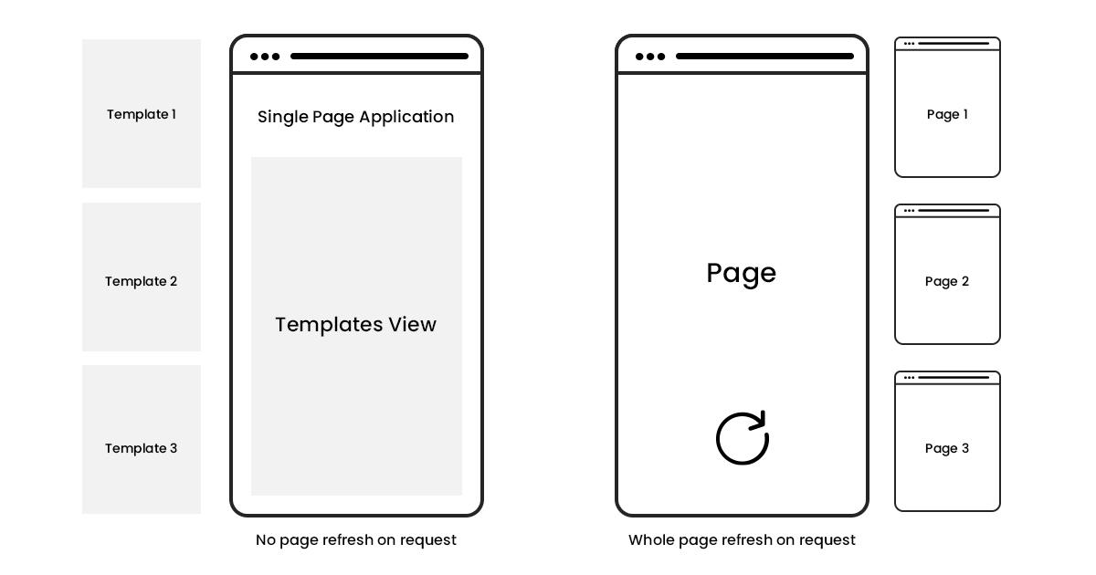
Single page application (SPA)
-App could be SPA but have some anchor elements with refresh but still SPA in the end
Notes:
Single page app : pinterest, Gmail, netflix Not single page app : jumia

Slide 5
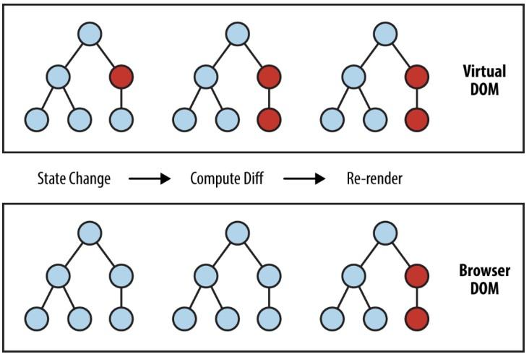
Virtual DOM
When new elements are added to the UI, a virtual DOM, which is represented as a tree is created.
Each element is a node on this tree. If the state of any of these elements changes, a new virtual DOM tree is created.
This tree is then compared with the previous virtual DOM tree, the virtual DOM calculates the best possible method to make these changes to the real DOM. This ensures that there are minimal operations on the real DOM.
The virtual DOM is only a virtual representation of the DOM
(a copy from real dom)
Notes:
1- https://blog.logrocket.com/virtual-dom-react/ 2- https://programmingwithmosh.com/react/react-virtual-dom-explained/ 3- https://jscomplete.com/playground/s674336

Slide 6
Getting started
Install node : https://nodejs.org/en/
Open new terminal in your directory.
Create new react app : npx create-react-app app-name
Enter your app folder.
Run your react app : npm start
Notes:
npm is a tool mainly used to install packages.
npx is a tool to execute packages.
if you want to execute a package without installing it on your computer and then launch it you can use npx directly.
Speaking of react , create-react-app is an utility to bootstrap a react project: if you use it with npx ( npx create-react-app my-app ) you will have your my-app project in place without the need to install create-react-app itself ( which will need another passage: npm install create-react-app and then create-react-app my-app)
This is great because you will never have an outdated version on your system, and every time you run it, you're getting the latest and greatest code available.
https://www.freecodecamp.org/news/npm-vs-npx-whats-the-difference/

Slide 7
Let’s explore our
React app structure
Notes:
App => parent component holds all others components
One html file with only one div in body [root id]
Index.js renders <App />
App.js imports App.css file [try to update it]
Import name => from path
Import without name => path only

Slide 8
Using sCss in react app
1- Change file extension to be .scss
2- Update import statement of your changed file if exists
3- Install sass => npm i sass
Important Note :
Write the Whole project in css or whole project in scss don’t mix
Notes:
React should have importing statement for images [its not related to scss or css its react handling]
import headerLogo from './image.jpg' [right]
<img src=’’ /> [wrong]

Slide 9
Ui libraries
1- Bootstrap
2- React bootstrap
3- Material ui
4- Semantic ui
5- Ant design

Slide 10
Integrating with ui library (bootstrap)
Notes:
1- https://create-react-app.dev/docs/adding-bootstrap/

Slide 11
Class vs Functional component
Component represent the part of user interface , before React Hooks ( will be discussed later ) when we want to create a dynamic component, we have to create a class component and use lifecycle methods to change states to make it reusable and encapsulate.
It is regular ES6 classes that extends component class form react library, also known as “stateful” components because they implement logic and state.It must have render() method returning html.
Notes:
1- https://www.geeksforgeeks.org/reactjs-class-based-components/
2- https://www.geeksforgeeks.org/differences-between-functional-components-and-class-components-in-react/

Slide 12
Class vs Functional component
Functional component :
const App = ( ) => {return (<h1> Hello </h1>)};
Class component :
class App extends Component{
render( ){
return (<h1> Hello </h1>)}
};

Slide 13
JSX
JSX stands for JavaScript XML and allows us to write HTML in React.
<p>{new Date()}</p>
Check some differences between jsx and html in notes part
Notes:
1- https://reactjs.org/docs/jsx-in-depth.html
2- https://www.geeksforgeeks.org/what-are-the-differences-between-jsx-and-html/
3- when using bootstrap make sure class is changed to be className instead

Slide 14
Handling Events
Example :
<button onClick={addUsers}>
Add Users
</button>
Important Note:
addUsers => function reference not function call
Handling events with React elements is very similar to handling events on DOM elements.

Slide 15
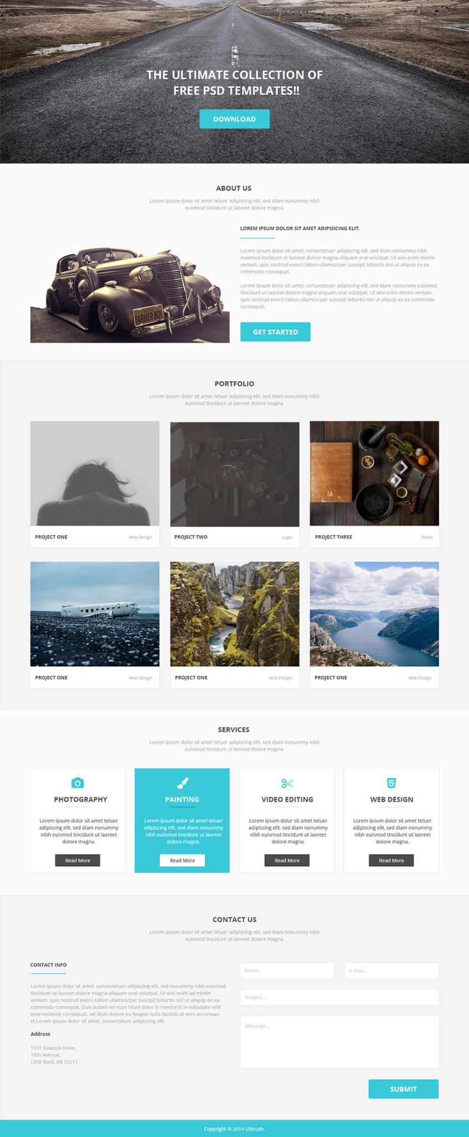
Reusable components

Slide 16
Thank you

Slide 17
Lecture 1
Lap

Slide 18
Props and State
Component needs data to work with. There are two different ways that you can combine components and data: either as props or state.
props
Props is short for properties and they are used to pass data between React components. React’s data flow between components is uni-directional (from parent to child only).
In a class component, props are passed by default. There is no need to add anything special, and they are accessible as this.props in a Component instance.

Slide 19
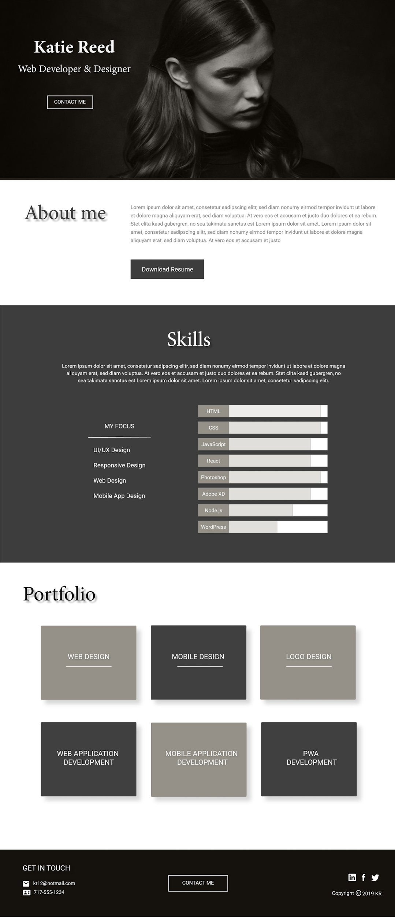
Task 1 : Portfolio
Create a web landing page using React js that contains the following sections :
Hero section
About me ( education and experiences ) section with a link to download resume
Skills section
Portfolio and projects section
Footer contains contact us section with social media icon links such as facebook , twitter , linkedin , github (react-fontawesom(icons library) library[Bonus])
Use Bootstrap as UI library
create reusable components for your page. And attach your wireframe [even on a white paper and catch it with ur phone camera]
Use any images u want

